Slide 1
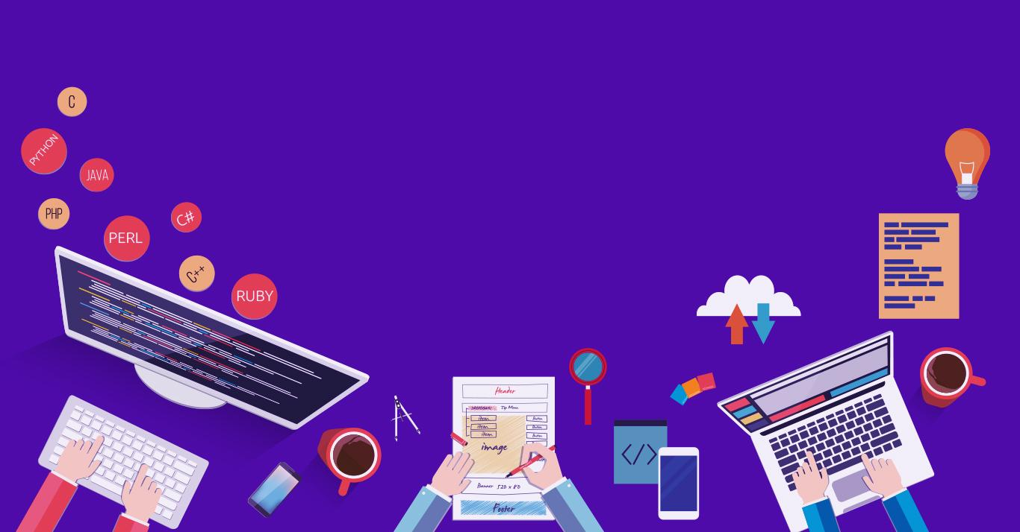

Mental Health Instruction
CHATBOT – Mental Health Instruction
210701010 – Abinesh R
210701025 – Alwyn Jose L
Dr.T.Kumaragurubaran., M.Tech., Ph.D
Computer Science and Engineering Department - REC

Slide 2
Problem Statement
How can we utilize AI chatbot and ML to handle our mental distress such as Anxiety, depression and suicidal thoughts.

Slide 3
Abstract
Mental health chatbot is an innovative voice-based mental health chatbot exclusively tailored to meet the diverse needs of students. Powered by cutting-edge natural language processing (NLP) technology, It offers personalized support for prevalent student challenges like stress, anxiety, and depression, all through empathetic voice interactions. Its intuitive interface provides real-time coping strategies, mindfulness exercises, and access to curated resources, empowering students to proactively manage their mental well-being. Upholding stringent privacy standards, It ensures confidentiality and creates a safe space for students to seek guidance and support without judgment.

Slide 4
Existing System
There are few chatbots that already exist such as WOEBOT,WYSA etc
Privacy issues with data collected.
Lacks personalized deep insights.
Limited by predefined responses , which can make their interactions feel repetitive and impersonal.

Slide 5
Proposed System
By transitioning from predefined responses to dynamically generated ones using advanced NLP and APIs, the proposed system aims to create a more responsive, empathetic, and effective mental health chatbot.
The proposed system aims to address the limitations of existing mental health chatbots by enhancing personalization, improving emotional recognition, ensuring privacy and expanding accessibility. These improvements are designed to provide more effective, empathetic, and secure mental health support.

Slide 6
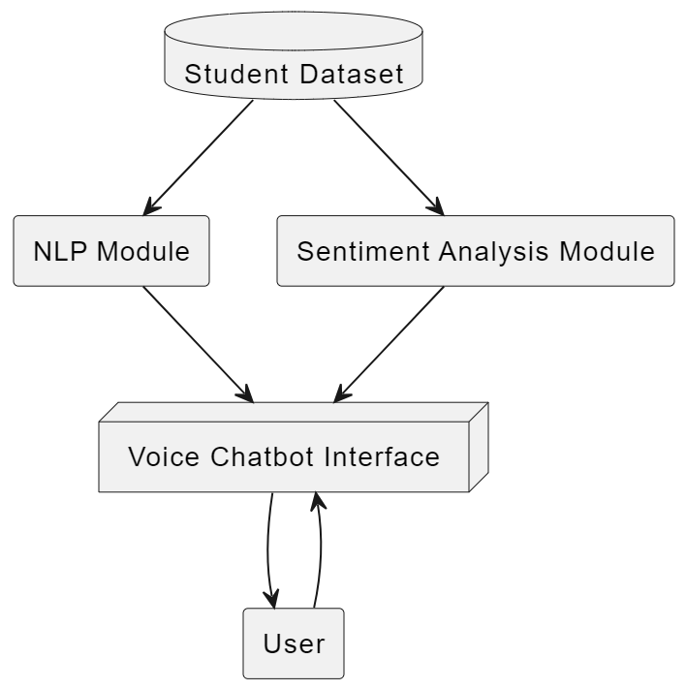
System Architecture

Slide 7
Modules
This single-module mental health chatbot system integrates advanced NLP, emotional analysis, and context management to provide personalized, empathetic, and secure mental health support. By leveraging dynamic response generation and real-time context awareness, the chatbot can effectively address the unique needs of each user, enhancing their overall mental well-being.

Slide 8
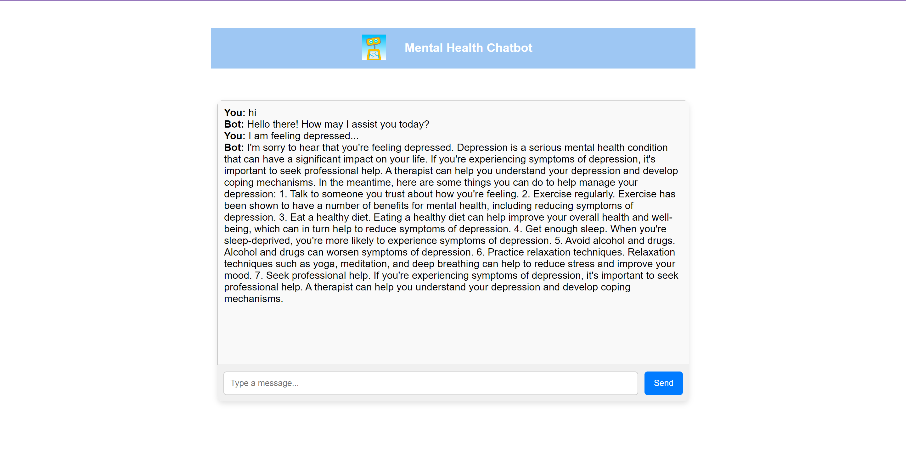
Output
Mental health chatbot with simplified UI

Slide 9
Conclusion
Our intelligent mental health chatbot leverages advanced NLP and machine learning to deliver personalized, empathetic support. It generates unique, context-aware responses, surpassing the limitations of predefined systems. Key features include dynamic response generation, real-time emotional analysis, and robust context management. Enhanced privacy and security measures protect user data, ensuring confident engagement. This project demonstrates AI's potential to improve mental health care accessibility and effectiveness.

Slide 10
Thank You

